Slide 1
Projet 7 Implémentez un modèle de scoring
Alexandre
Jeandel
2024/04

Slide 2
Introduction
La mission :
Construire un modèle de scoring qui donnera une prédiction sur la probabilité de faillite d'un client de façon automatique.
Analyser les features qui contribuent le plus au modèle, d’une manière générale (feature importance globale) et au niveau d’un client (feature importance locale), afin, dans un soucis de transparence, de permettre à un chargé d’études de mieux comprendre le score attribué par le modèle.
Mettre en production le modèle de scoring de prédiction à l’aide d’une API et réaliser une interface de test de cette API.
Mettre en œuvre une approche globale MLOps de bout en bout, du tracking des expérimentations à l’analyse en production du data drift.

Slide 3
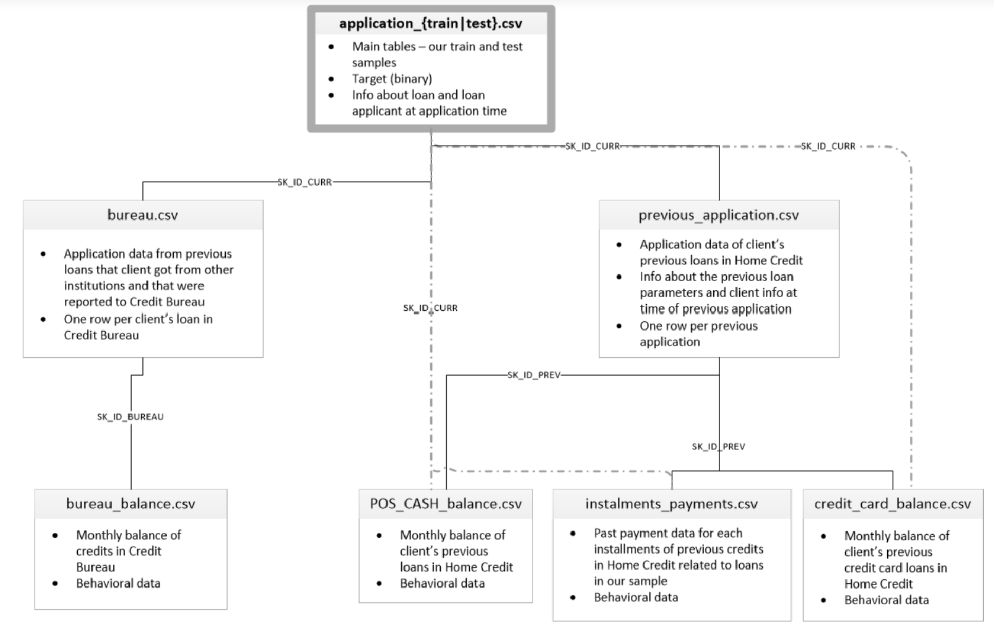
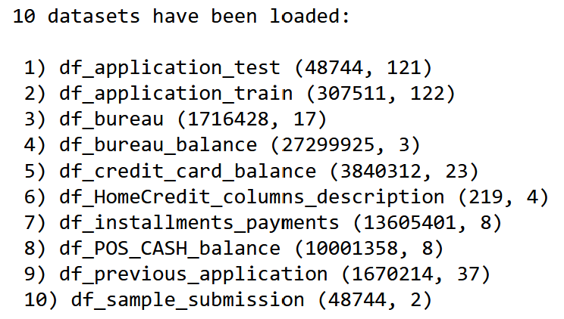
Data source
https://www.kaggle.com/c/home-credit-default-risk/data
Notes:
TEST

Slide 4
Data preparation
Categorical Data Encoding: One-hot encoding to transform categorical variables into a machine-learning-friendly format.
Missing Value Handling: Replacing specific abnormal values with NaN for accurate representation.
Feature Engineering: Created new features through ratios, differences, and transformations to capture critical aspects of the data, like financial ratios.
Data Aggregation: Applied comprehensive aggregations (mean, max, min, sum) across multiple datasets to summarize historical and financial data at the customer level.
Dimensionality Reduction for Categorical Data: Aggregated categorical data to reduce dimensionality while preserving essential information through mean values.
Resource Management: Employed garbage collection to efficiently manage memory by removing temporary variables and ensuring resource optimization.

Slide 5
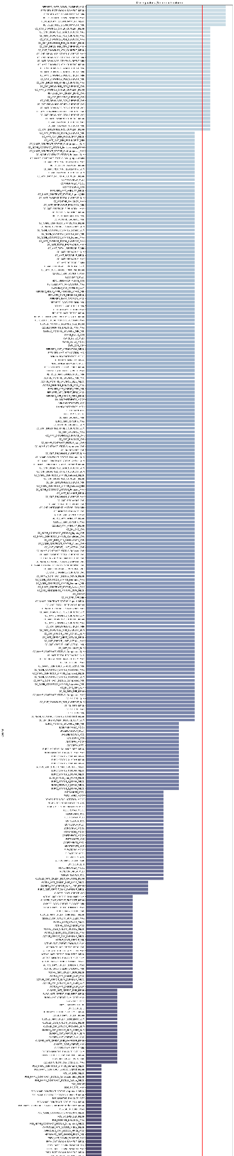
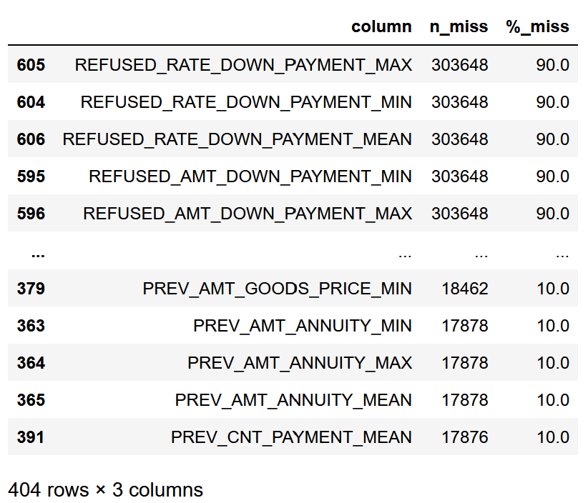
Data cleaning
Some features have an important quantity of missing values.
The threshold is an a parameter we can optimize once the best model was selected.
0.75
Other steps : Checking for duplicates
Handling missing values with different imputer (avg, most frequent…)
Handling outliers (negative & infinite values, temporal values, etc.)

Slide 6
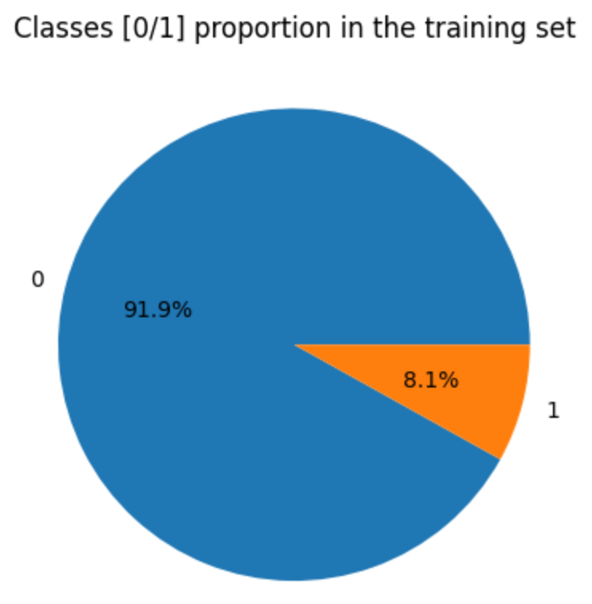
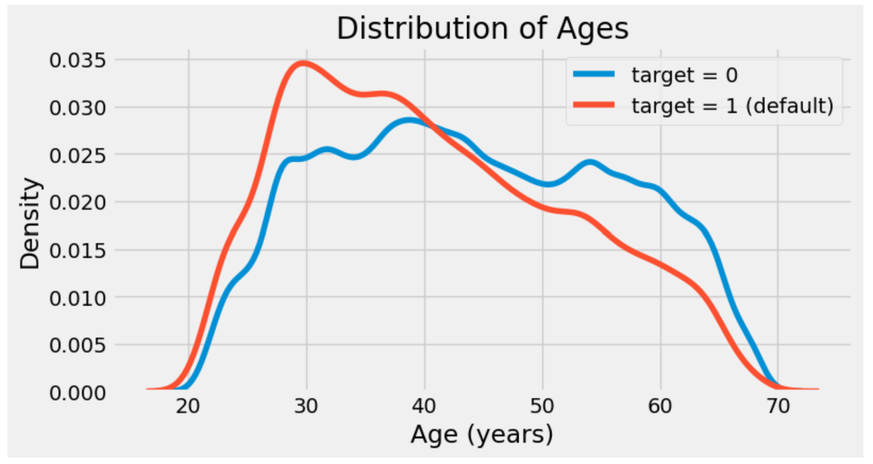
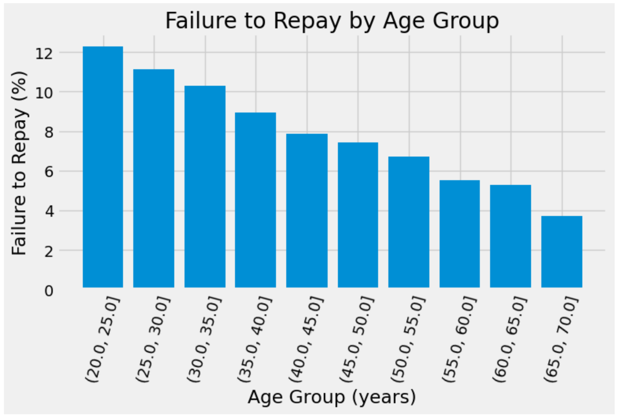
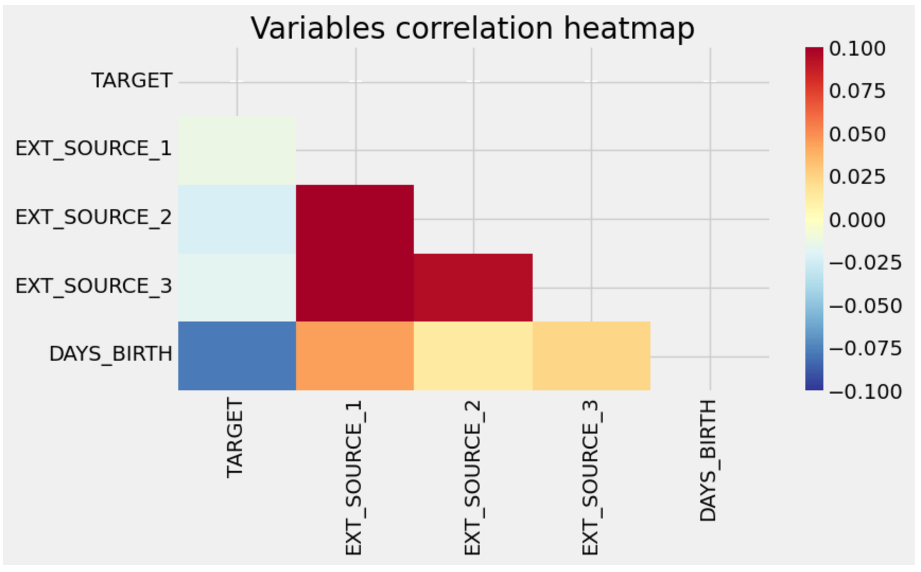
Data overview

Slide 7
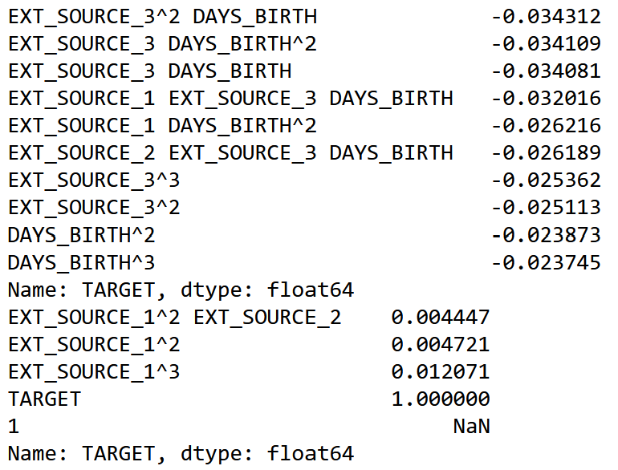
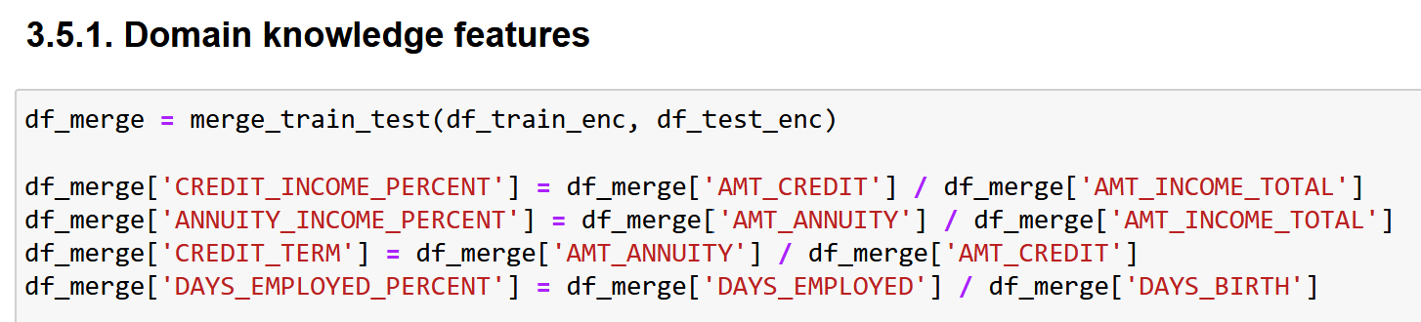
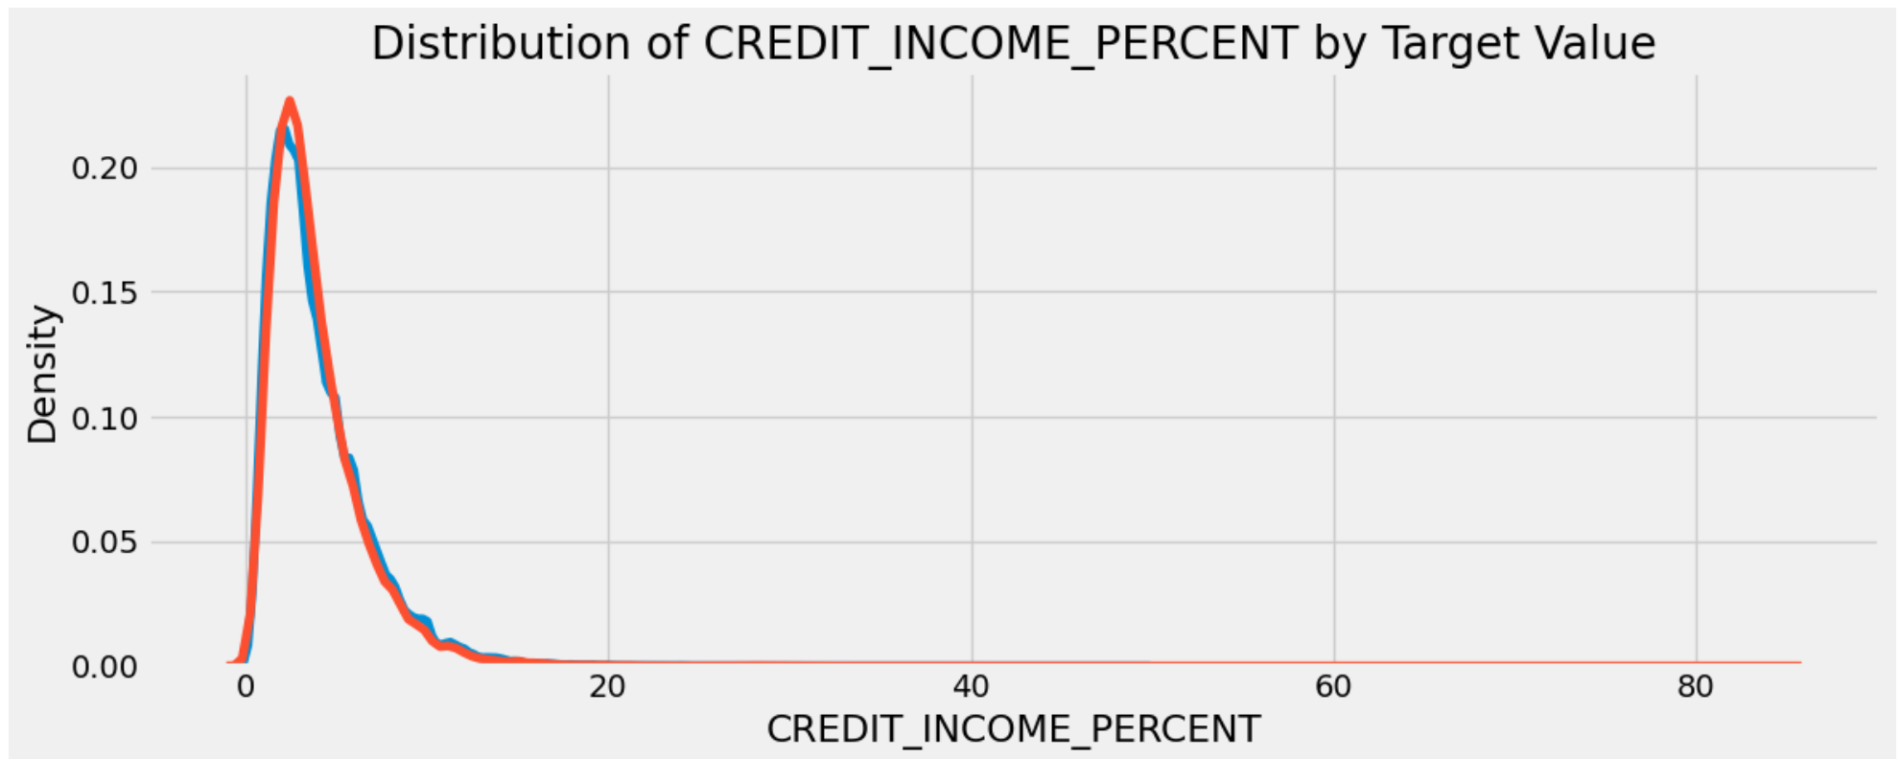
Features engineering
Polinomial features CORR
Domaine knowledge features

Slide 8
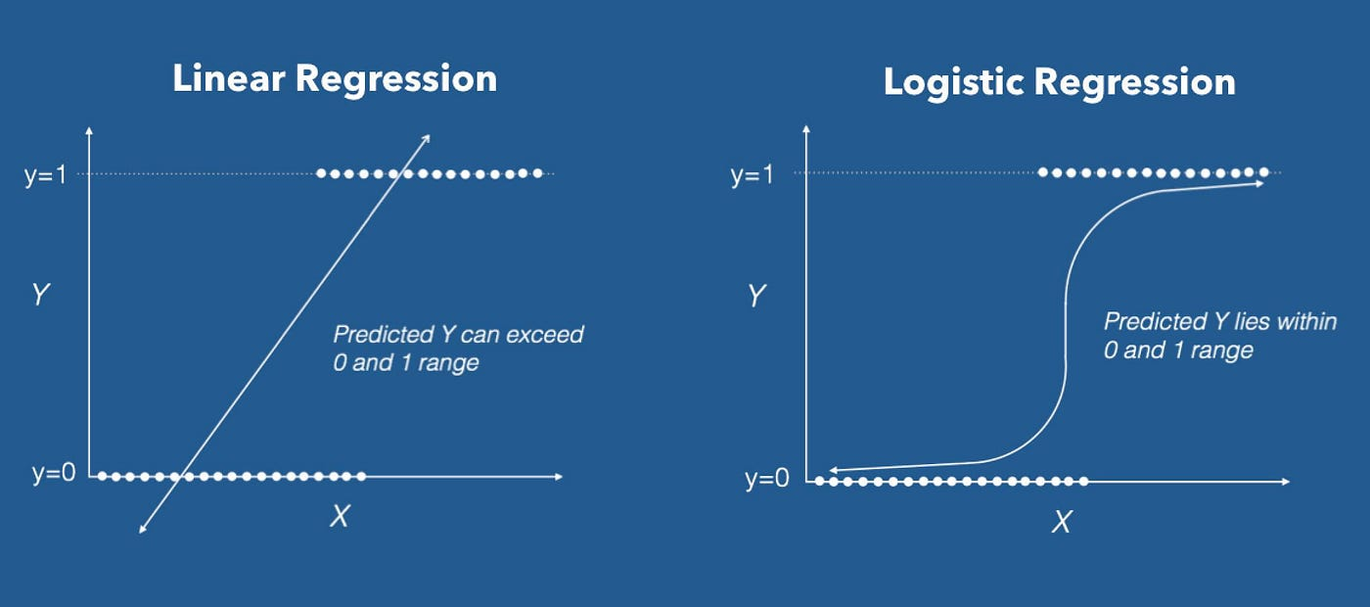
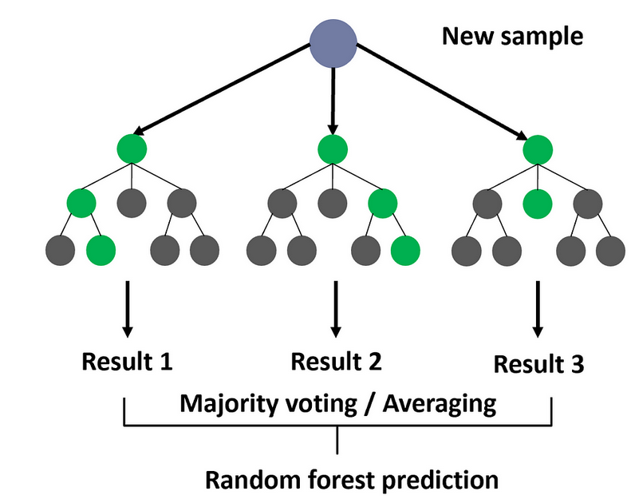
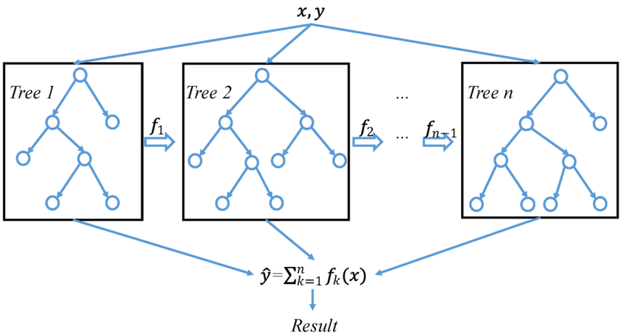
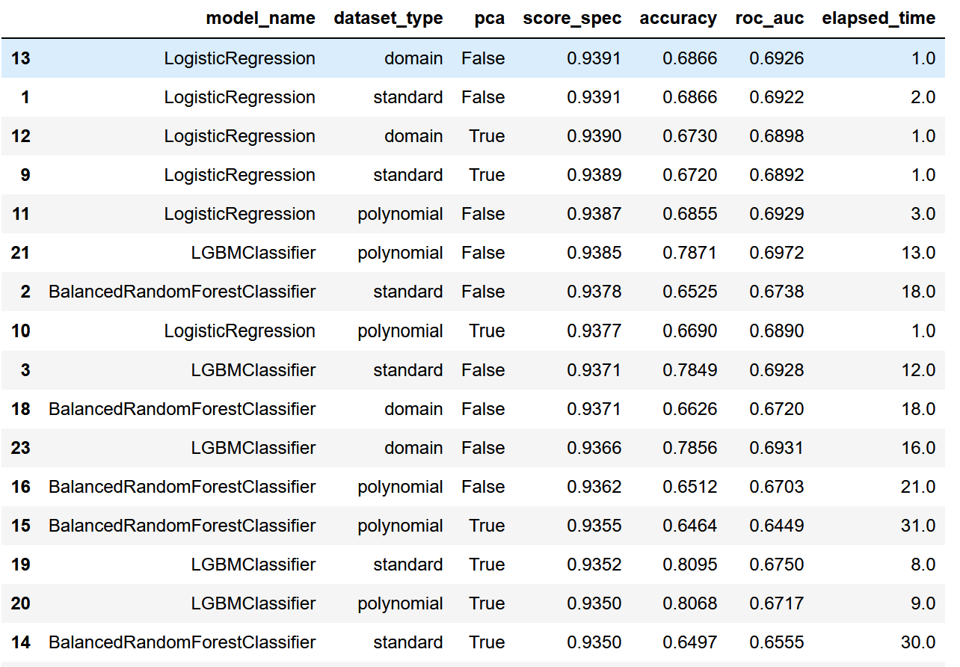
Features engineering
Dummy
Logistic regression
Random Forest
Light gradient boosting
GridSearchCV
Standard
Polynomial
Domain
PCA 0.8
No PCA
Spec (business score)
Accuracy
Roc
Elapse time

Slide 9
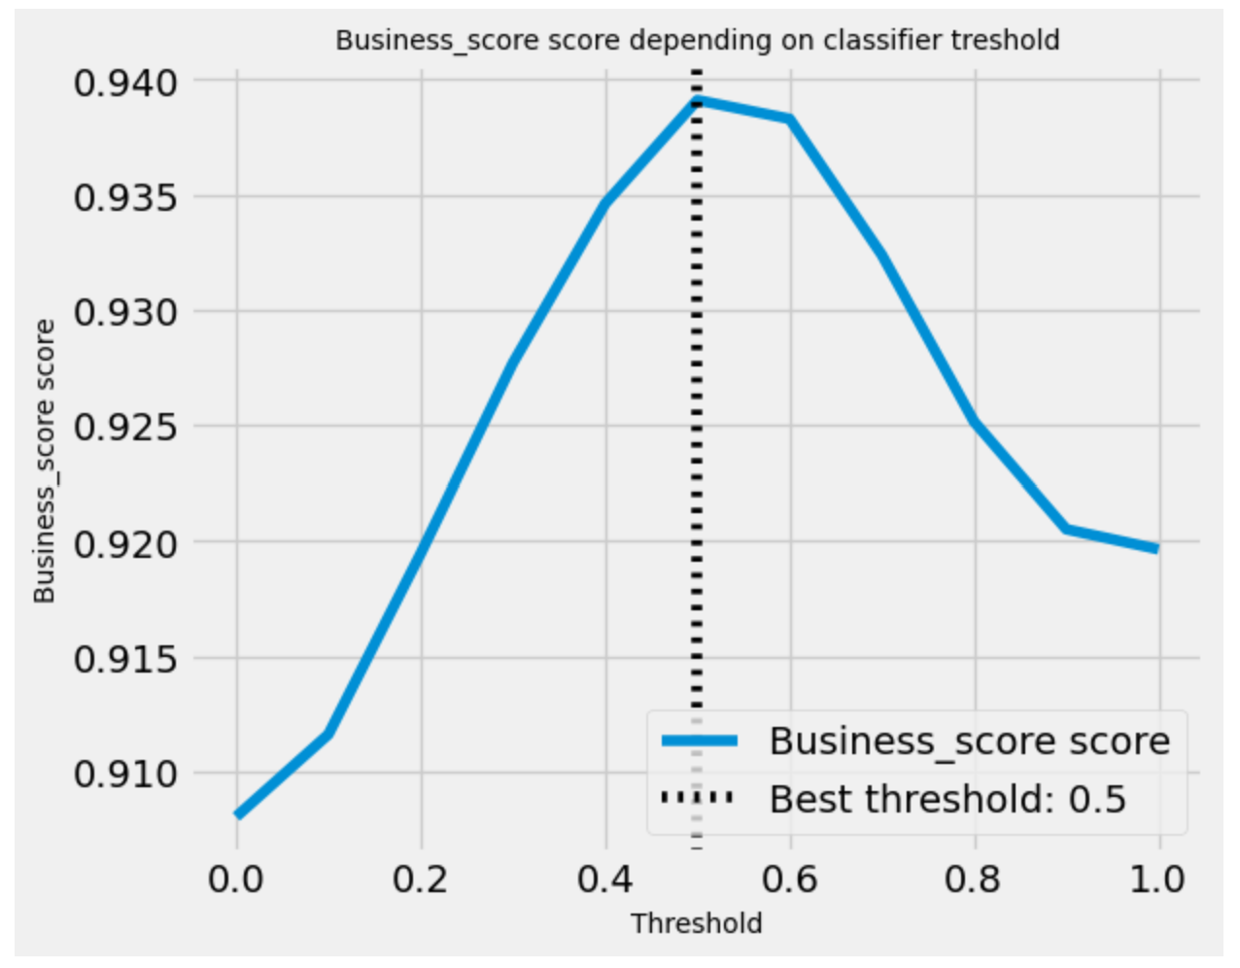
Threshold optimization

Slide 10
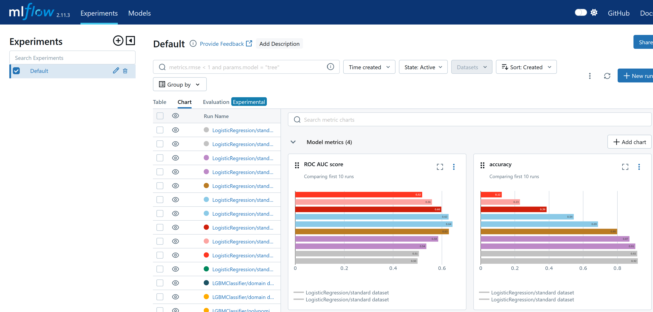
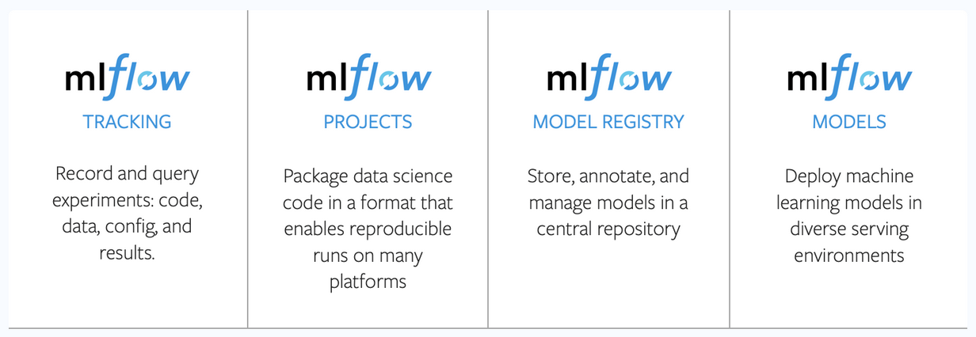
MLFlow UI tracking
MLflow provides a unified platform to navigate the intricate maze of model development, deployment, and management.

Slide 11
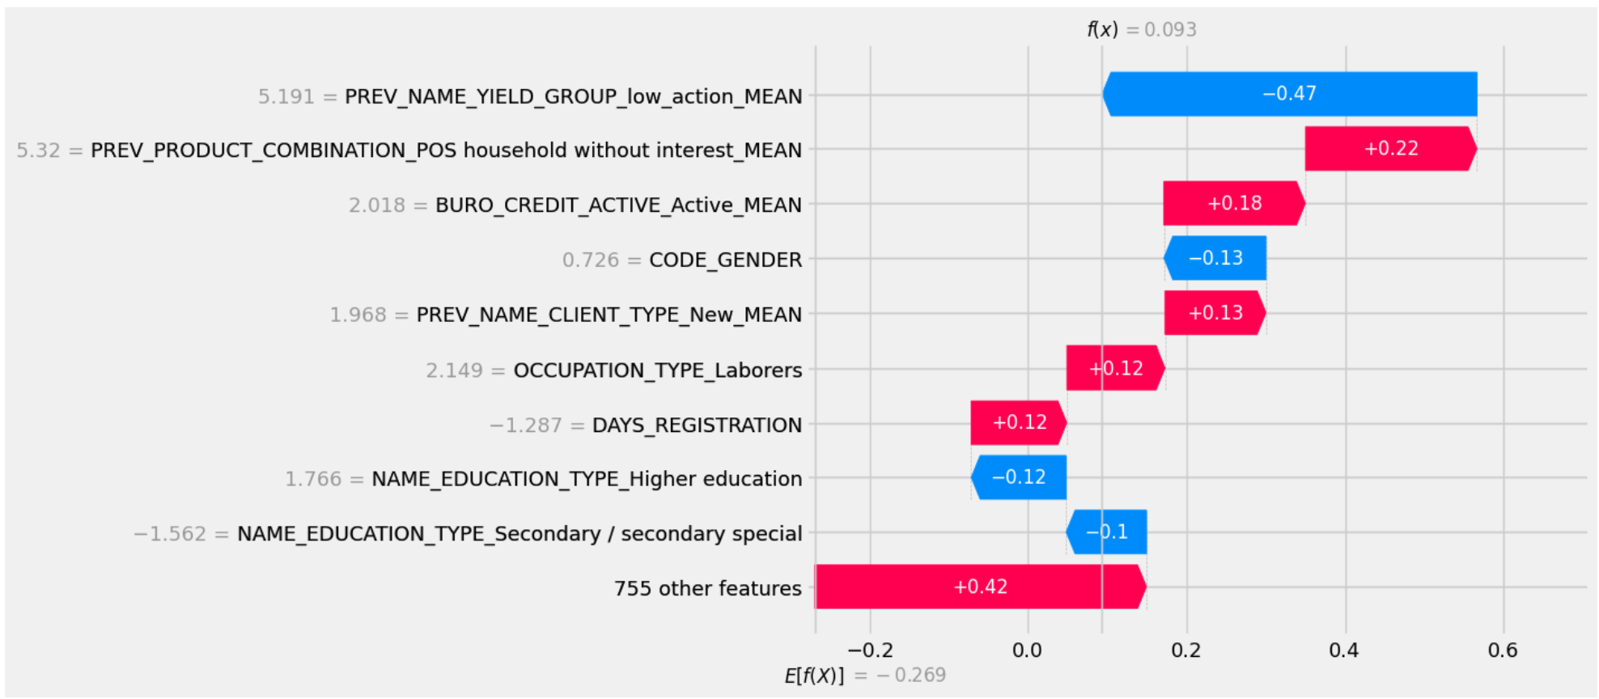
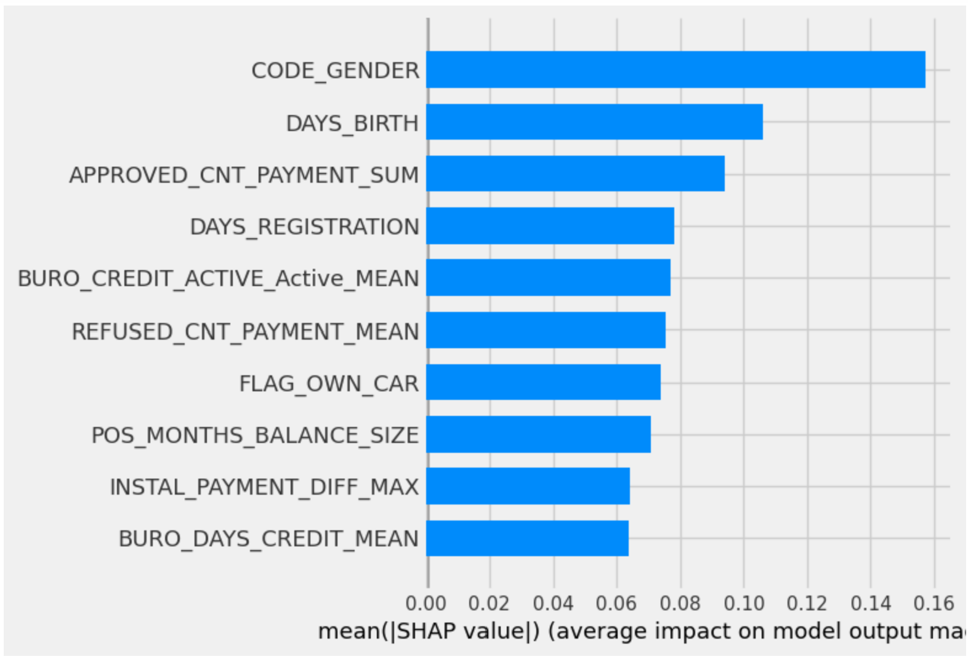
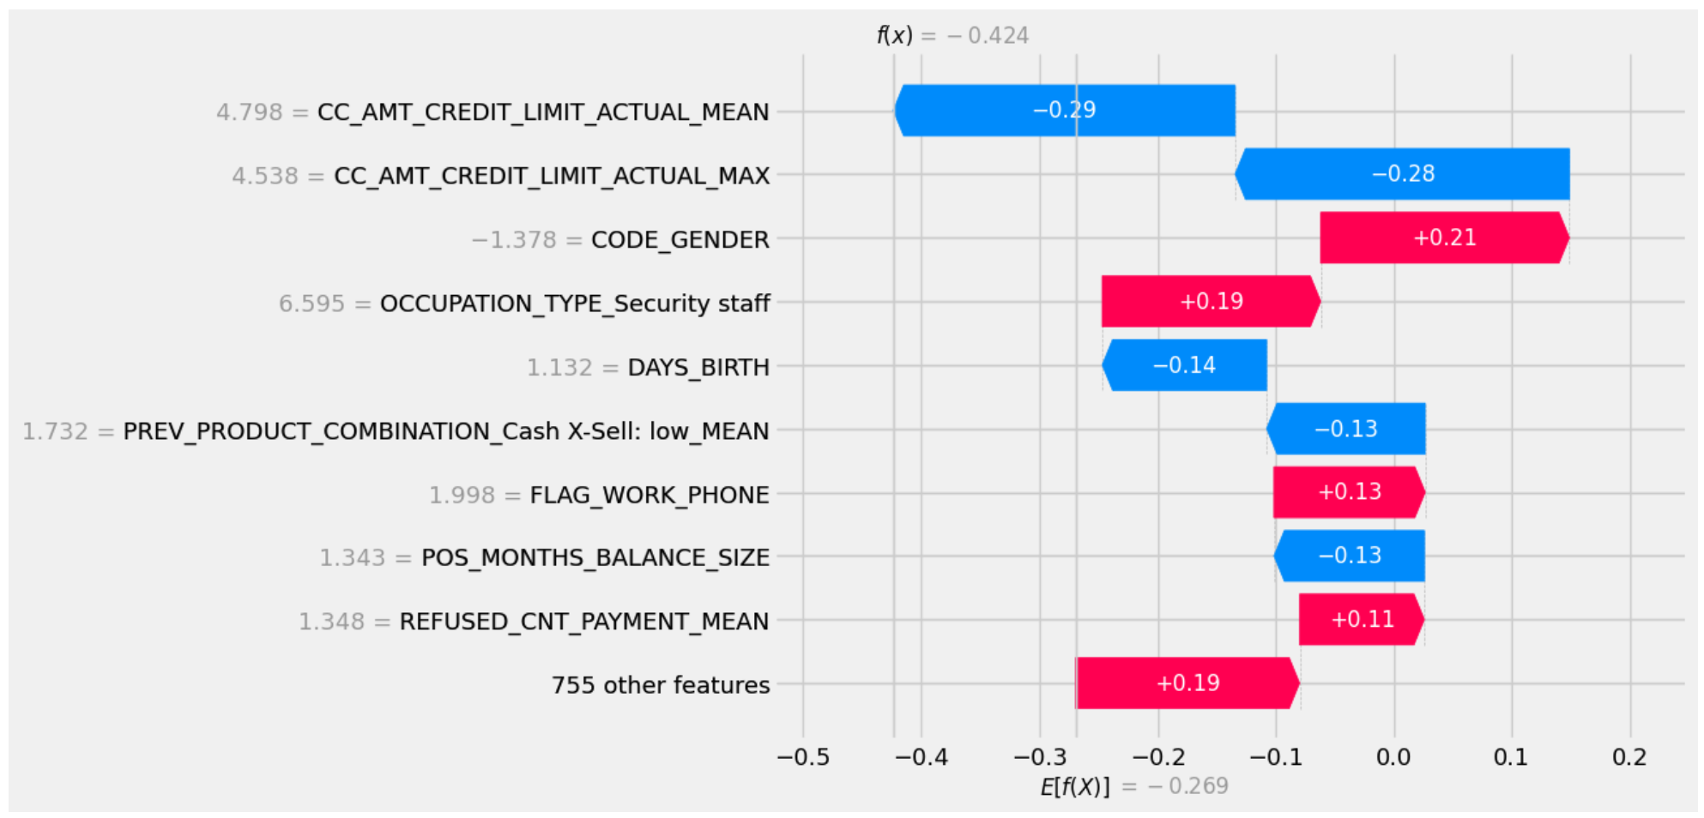
Features importance
0
1

Slide 12
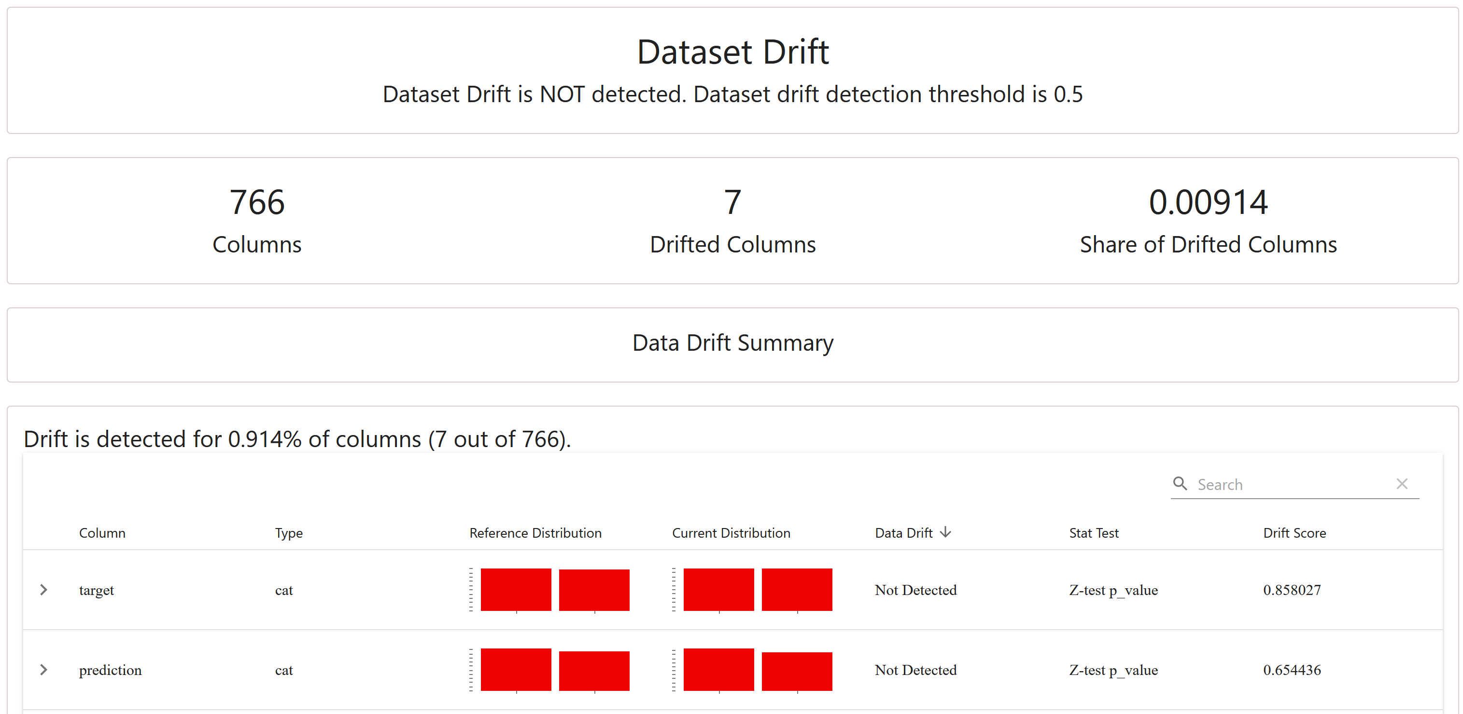
Data drift
"Drift" is a term used in machine learning to describe how the performance of a machine learning model in production slowly gets worse over time.

Slide 13
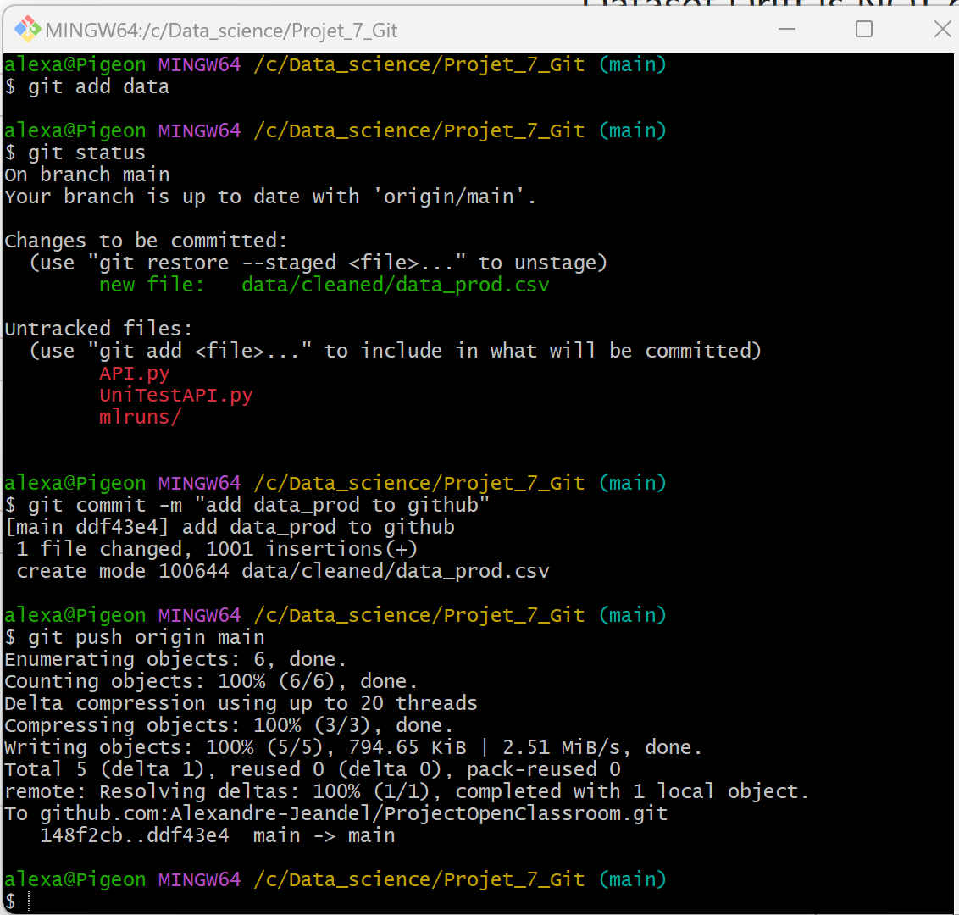
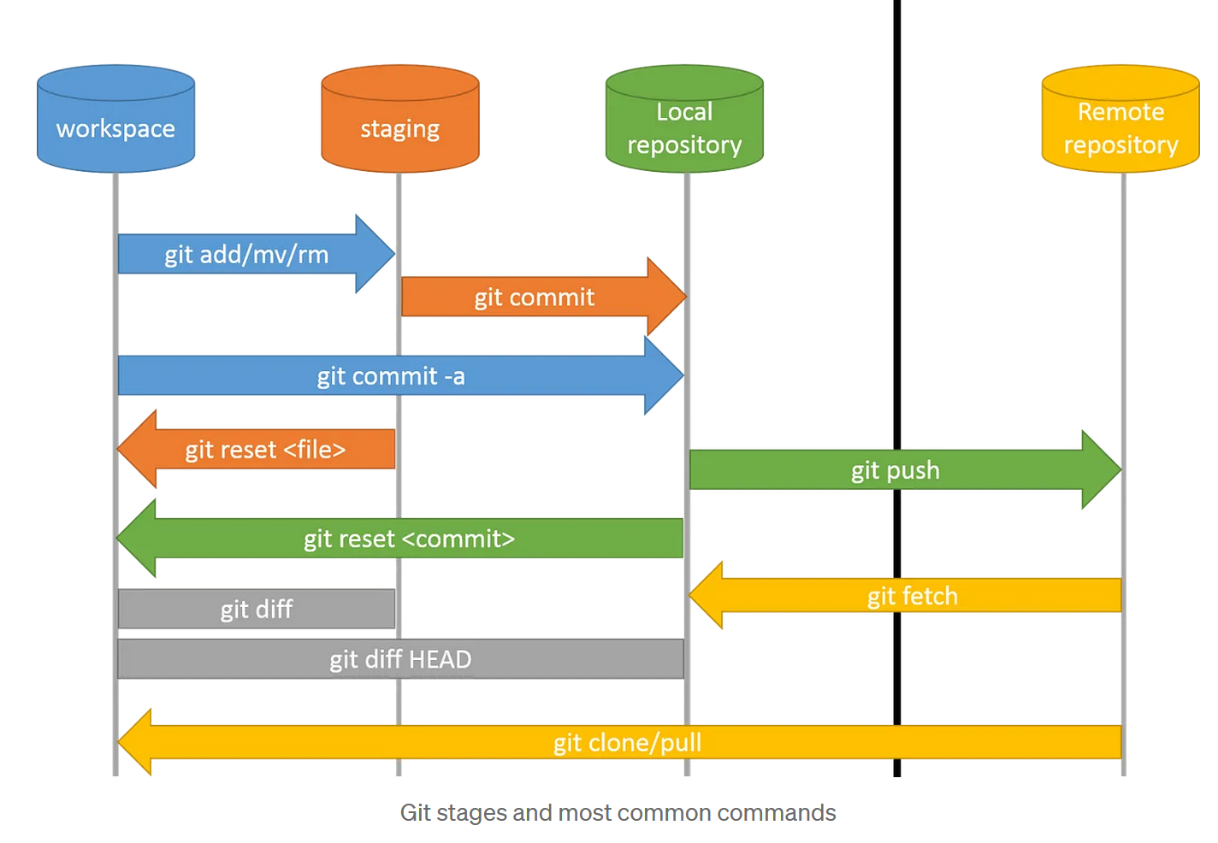
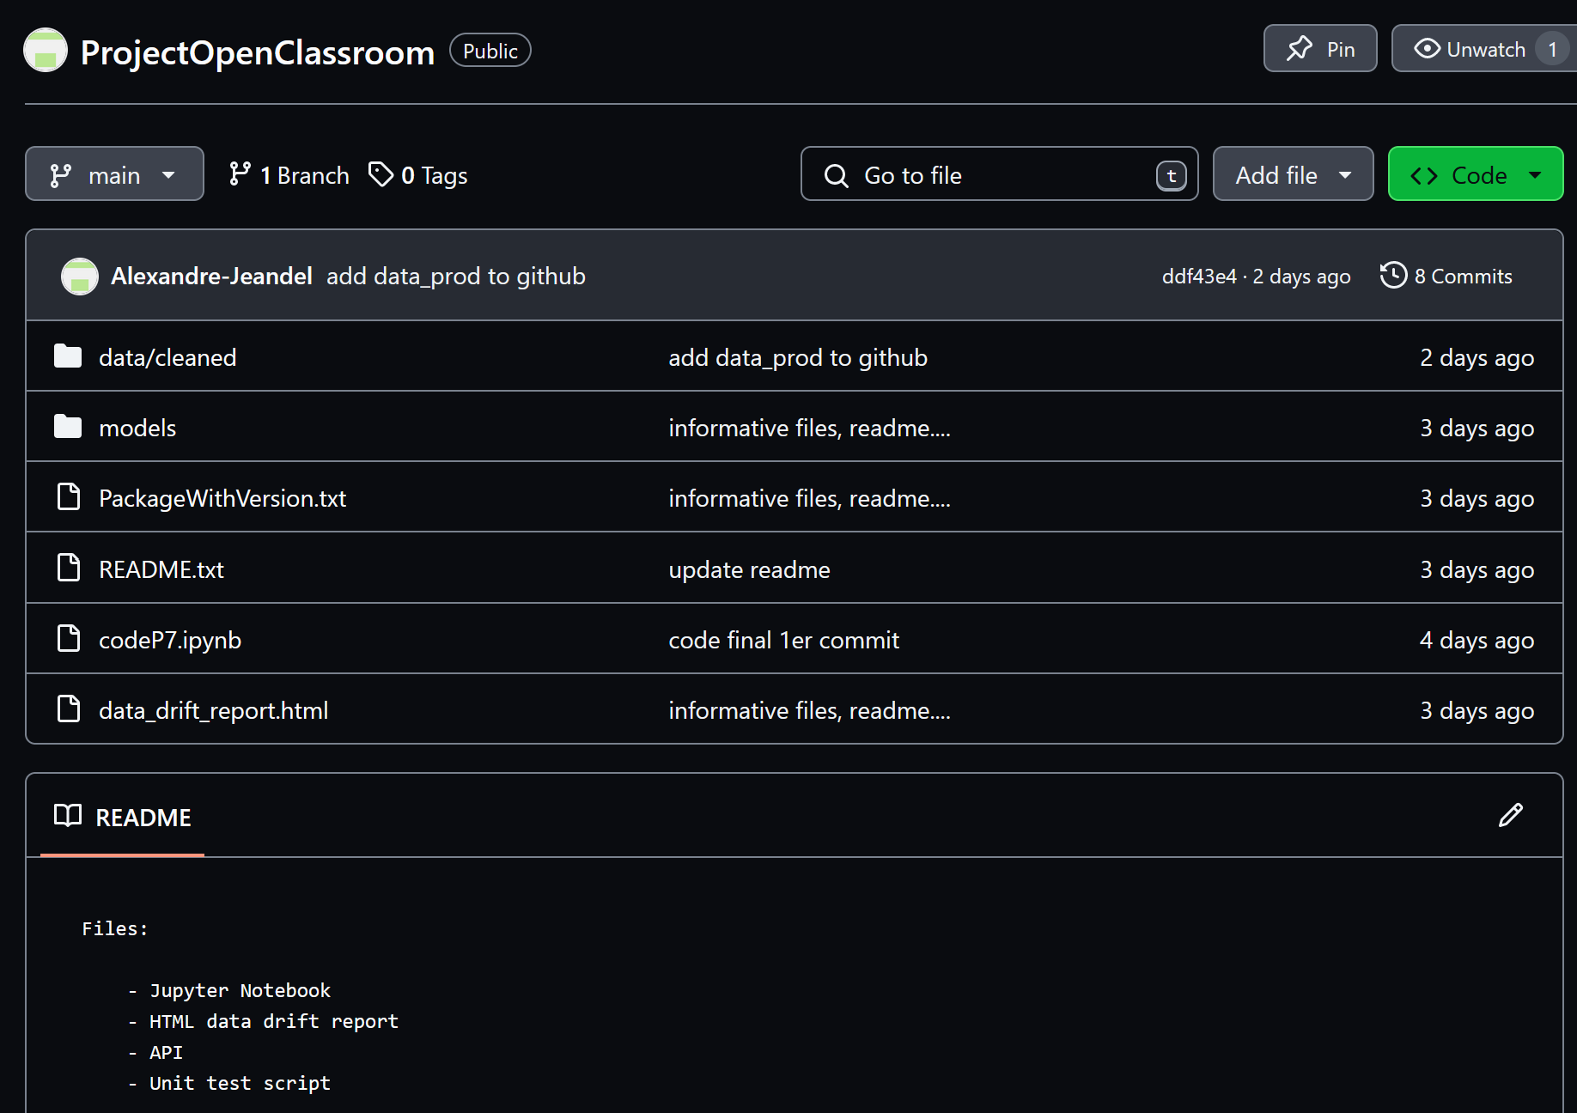
Github Repo
My repo link
CD LS Status ADD COMMIT PUSH

Slide 14
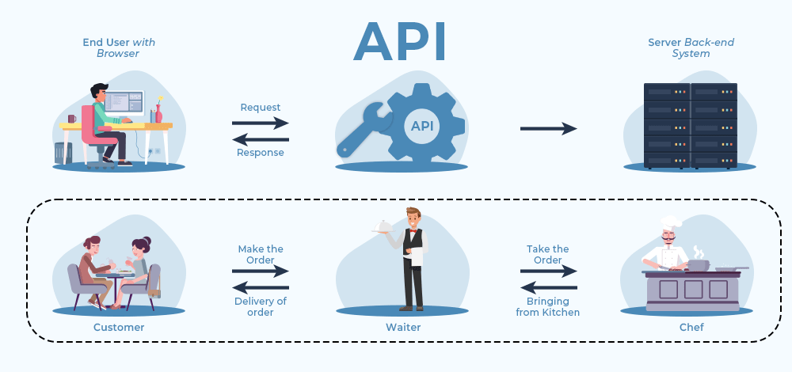
API
Application Programming Interface

Slide 15
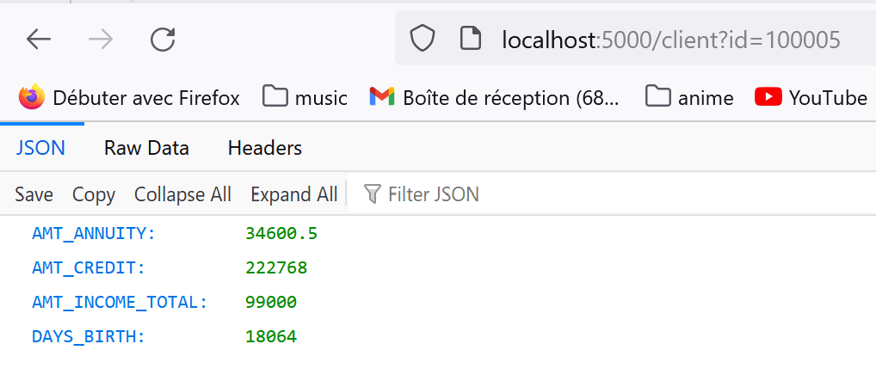
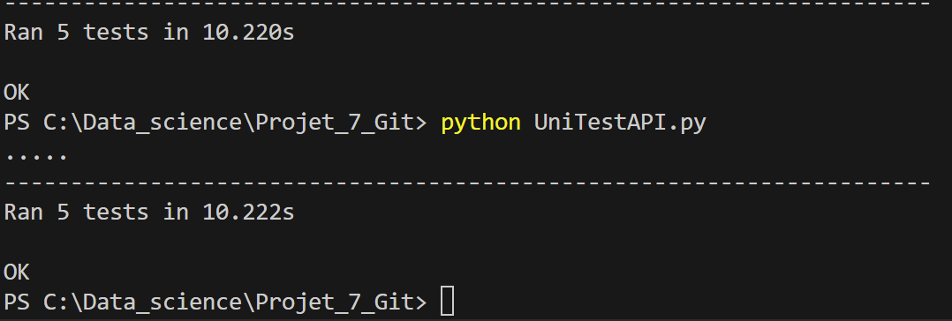
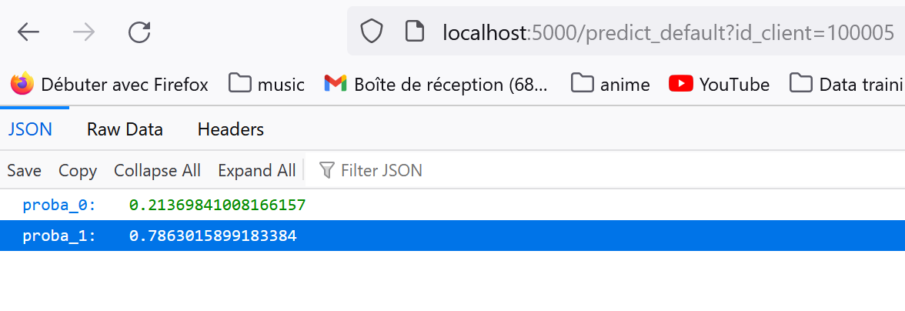
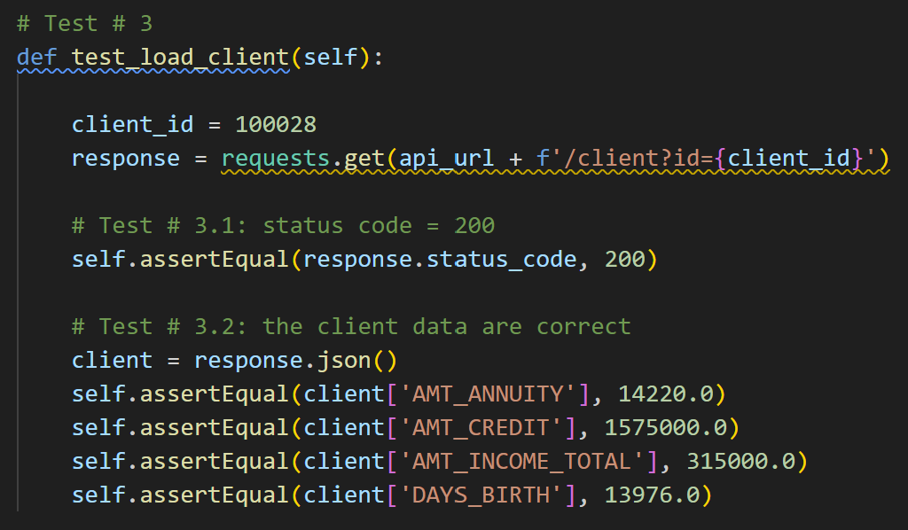
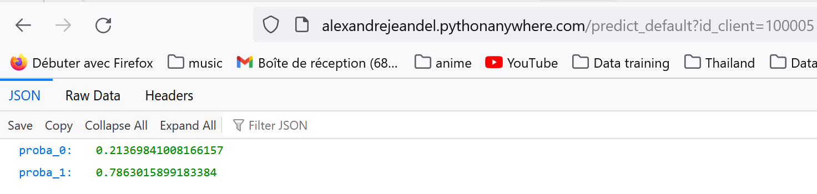
API
Application Programming Interface

Slide 16
Thank you for listening

